Slide 1
Financial Time Series Analysis
Prof. Michael Ketzenberg

Slide 2
Agenda
Overview of Time Series
Purpose
Components
Regression Analysis
Time as a predictor
Auto-regressive functions
Smoothing Methods
Momentum
Moving averages
Exponential Smoothing

Slide 3
Overview of Time Series Analysis
Time series generally requires an entire semester of study.
A time series is simply a series of data points ordered in time.
Goal in analyzing a particular time series is to:
Understand the underlying mechanism of price movements.
Make predictions regarding future price movements.
Build a model for the data.
Identify the time-series components
Reduce the series to some kind of standard “random noise”.
The point is that when we have such “noise” we have extracted all useful information.

Slide 4
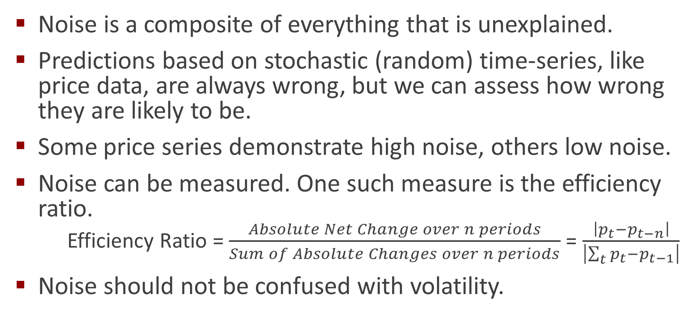
Noise (aka Randomness)
Noise is a composite of everything that is unexplained.
Predictions based on stochastic (random) time-series, like price data, are always wrong, but we can assess how wrong they are likely to be.
Some price series demonstrate high noise, others low noise.
Noise can be measured. One such measure is the efficiency ratio.
Efficiency Ratio = $\frac{Absolute Net Change over n periods}{Sum of Absolute Changes over n periods}$ = $\frac{\left|p_{t}−p_{t−n}\right|}{\left|\sum_{t}{p_{t}−p_{t−1}}\right|}$
Noise should not be confused with volatility.

Slide 5
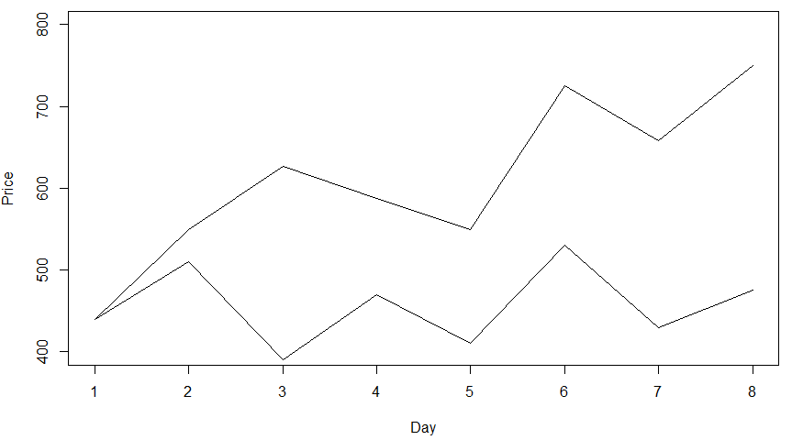
Measuring Noise and Volatility
Sum of absolute change: 598
Net Change: 310
Efficiency Ratio: 0.52
Low Noise
High Noise
Sum of absolute change: 595
Net Change: 35
Efficiency Ratio: 0.06

Slide 6
The Achilles’ Heel of Time Series Analysis
The Future Must Behave Similarly to the Past.

Slide 7
On the Nature of Price Movements
The contention by many is that there is no relationship between price movements from one day to the next.
The random walk theory of price movement
If so, then many well-defined trading methods will fail.
Arguments against the contention:
Success of many algorithmic trading strategies
Markets move on anticipation

Slide 8
More on Price Movement
Price movement can appear to be random
Level of noise depends on the time interval and frequency of data
Shorter term, higher frequency data exhibit more noise
In the long run, prices seek a level of equilibrium
Prices do not have a normal distribution
Prices exhibit fat tails
Fat tails also mean that some other part of the distribution must be different.

Slide 9
Price Movement Creates Trading Opportunities
Non-random price movement is captured in the components of time series:
Trend
Season
cycle
Long-term trends capture large price moves caused by fundamental factors.
Persistence. Some stock price moves simply defy analysis.
They continue to rise beyond any normal assessment of value.
Only by staying with the trend could you capture the gains of Apple, Amazon, Tesla, and even Bitcoin.

Slide 10
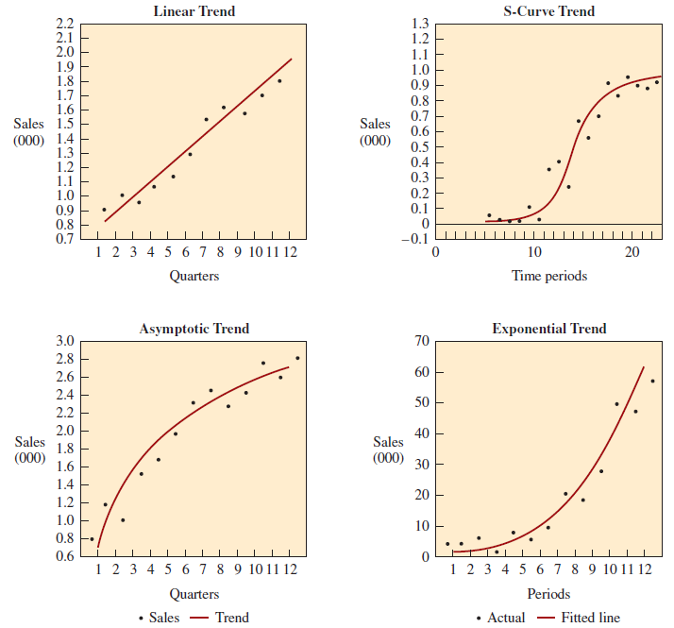
Trend Comes in Many Forms
Price
Price
Price
Price

Slide 11
Trend is Only One Piece of the Puzzle
Price

Slide 12
What Can Time Series Handle?
Average
Trend
Seasonal element
Cyclical element(s)
Autocorrelation
Random noise
Time Series Complexity
The bigger the model, the more “components” of demand can be handled (i.e., the model breaks down more elements of variability).
Even small models, such as a simple moving average, often work well for stable systems.
Only add complexity when the trade-off between interpretation and accuracy warrants examining the additional layers of variability.

Slide 13
Two Approaches to Time-Series Analysis
Regression analysis:
Using time as a predictor
Leveraging Autocorrelation in Autoregressive (AR) models:
Smoothing Methods
Momentum
Moving averages
Exponential smoothing

Slide 14
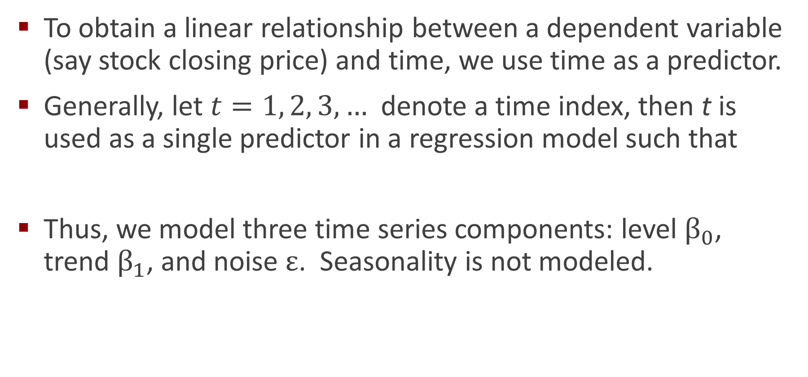

Time-Based Regression Analysis
To obtain a linear relationship between a dependent variable (say stock closing price) and time, we use time as a predictor.
Generally, let $t=1, 2, 3,…$denote a time index, then t is used as a single predictor in a regression model such that
Thus, we model three time series components: level $β_{0}$, trend $β_{1}$, and noise $ε$. Seasonality is not modeled.
$$y_{t}=β_{0}+β_{1}t+ε$$

Slide 15
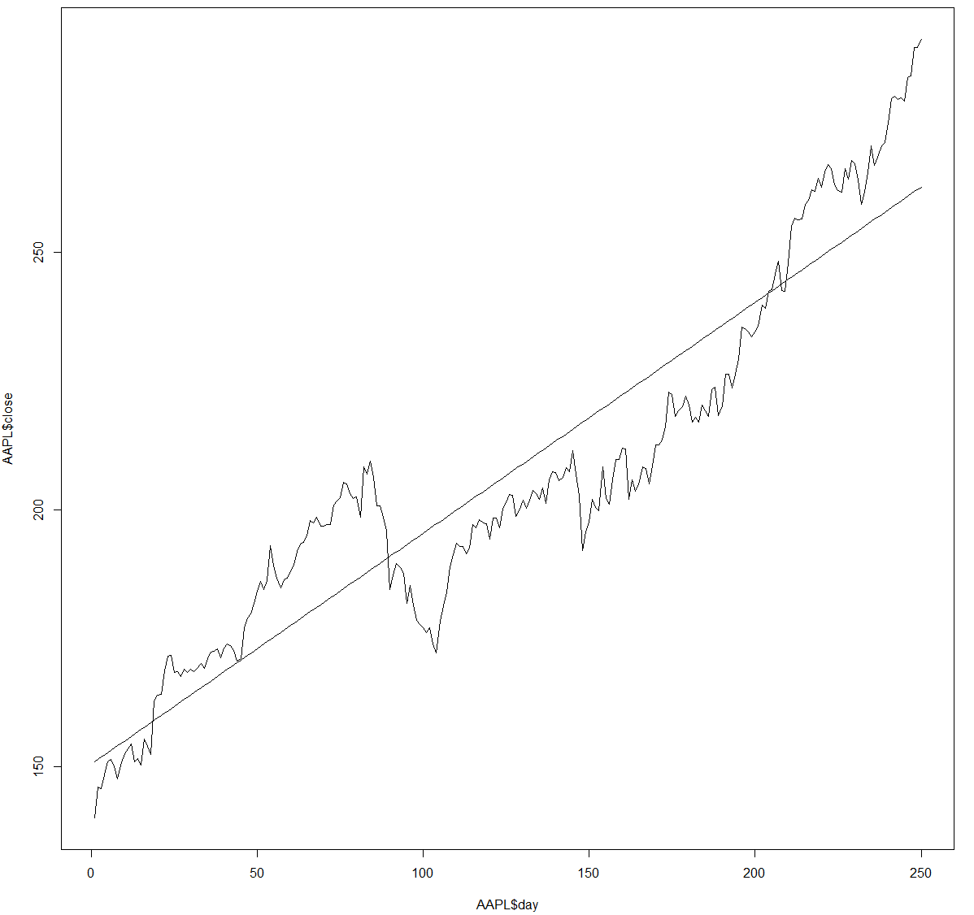

Model Estimation
$${\hat{y}}_{t}=b_{0}+b_{1}t$$

Slide 16
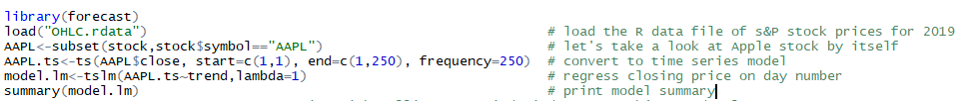
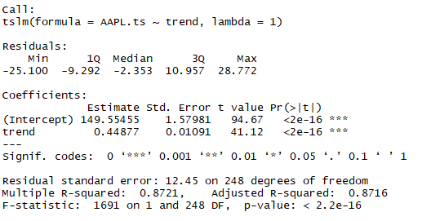
Let’s See the Magic of R
Coefficients: Intercept and X values and their related standard errors.
t-statistic (aka t-value): coefficient/std.error ==> small value indicates variable has little/no effect on outcome. The larger, the better!
Pr(>|t): probability of observing this t-value if coefficient is zero. Small is good!
R-squared: goodness of fit 0 to 1, 1 is too good of a fit. Closer to 1 is great!
F-statistic: assess if the model better than "guessing“ at chance alone. Larger is better!
p-value: probability of seeing an F-value this “large” by chance alone. Same as Pr(>|t) as smaller is better for the “overall” model!

Slide 17

The Time-Based Regression Plot for AAPL
$${\hat{y}}_{t}=150.55+0.45t$$

Slide 18
Choosing the Number of Periods
Why use all of the periods? In the case of AAPL this is 250 days.
Why not use all of the periods?
What is an essential tradeoff in selecting the number of periods?
Also, need to split data into training and testing subsets.

Slide 19
Creating Rolling Regressions with 20 days in RStudio
We will use 20 days of data – the most recent 20 days to predict the closing price of AAPL for the next trading day.
Therefore, the first prediction will be for day 21 using the data from day 1 through day 20.
The last prediction will be for day 250 using the data from day 230 through day 249.
We will assess the errors in our predictions using absolute errors since, otherwise, under predicted values will offset over predicted values and thereby artificially lower the error rate.

Slide 20
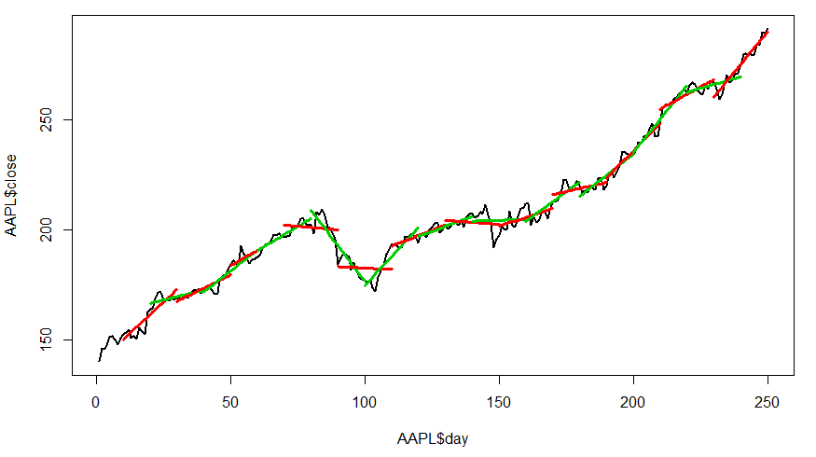
Rolling Regression with a 20 Day Window
Training
Testing

Slide 21
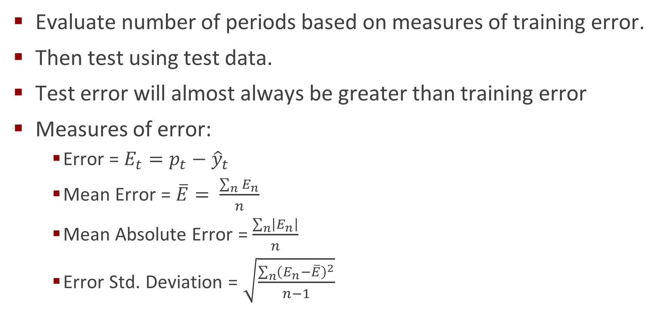
What is the Best Choice for the Number of Periods?
Evaluate number of periods based on measures of training error.
Then test using test data.
Test error will almost always be greater than training error
Measures of error:
Error = $E_{t}=p_{t}−{\hat{y}}_{t}$
Mean Error = $\overline{E}= \frac{\sum_{n}{E_{n}}}{n}$
Mean Absolute Error = $\frac{\sum_{n}{\left|E_{n}\right|}}{n}$
Error Std. Deviation = $\sqrt{\frac{\sum_{n}{{\left(E_{n}−\overline{E}\right)}^{2}}}{n−1}}$

Slide 22
Class Exercise: Rolling Regressions in R
Evaluate different rolling horizon regression models using the time series data for Apple (AAPL).
Use periods 1-200 as the training data and 201-250 as the testing data.
Use the forecast command to generate a prediction of closing price the one period after the horizon end period.
So if you are looking at a 10 period horizon, generate your first linear regression model using Apple closing prices for periods 1-10, then generate a forecast for period 11. Calculate the absolute error (actual-predicted) for period 11 and save it into a vector
Next, calculate the next rolling horizon regression model for periods 2-11, and then generate a forecast for period 12. Calculate the absolute error and save it in a vector.
Continue on until you have created regression models using all the training data.
Calculate the absolute mean error cross all training periods
Redo the above analysis for rolling horizons of between 3 and 25 periods. Which one is best? Well, it will be the one with the lowest mean absolute training error.
Now calculate the test error for the best method you identified in the previous step. Report the mean absolute testing error that arises over the testing data.

Slide 23
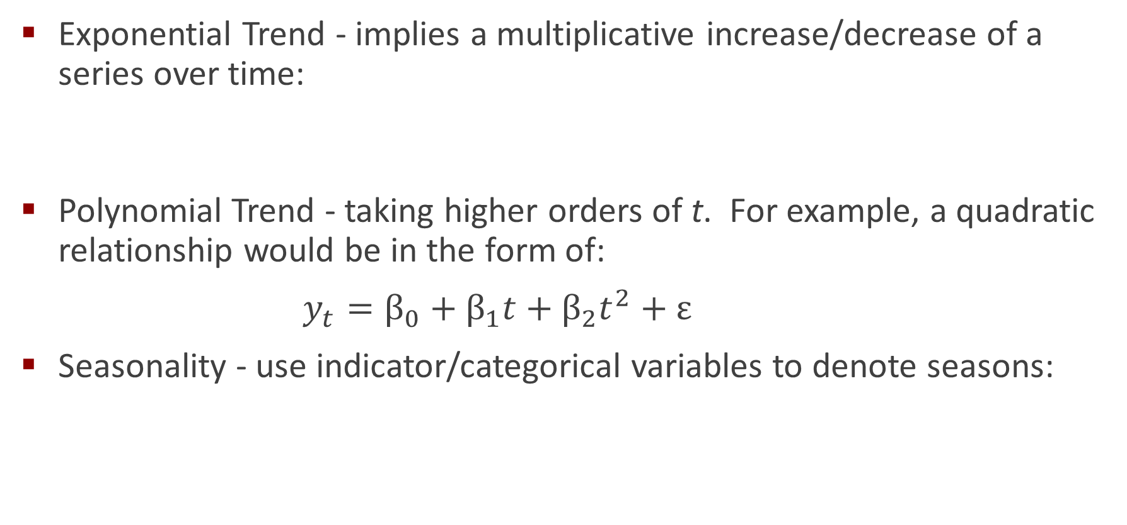
Modeling Non-Linear Trends and Seasonality
Exponential Trend - implies a multiplicative increase/decrease of a series over time:
Polynomial Trend - taking higher orders of t. For example, a quadratic relationship would be in the form of:
${y_{t}=β}_{0}+β_{1}t+β_{2}t^{2}+ε$
Seasonality - use indicator/categorical variables to denote seasons:
$${\log{y_{t}}=β}_{0}+β_{1}t+ε$$
$${y_{t}=β}_{0}+β_{1}t+β_{2}S_{2}+β_{3}S_{3}{+β}_{4}S_{4}+ε$$

Slide 24
Auto-Regressive (AR) Models
In the context of a time-series and trends in the time-series, it is likely that neighboring periods will tend to be correlated.
The term autocorrelation arises because it describes the correlation between a time-series and itself.
To compute autocorrelation, we compute the correlation between the series and a lagged version of the series.
A lagged series is simply a copy of the original series, moved foreword one or more periods: i.e. lag-1, lag-2, …, lag-n.

Slide 25
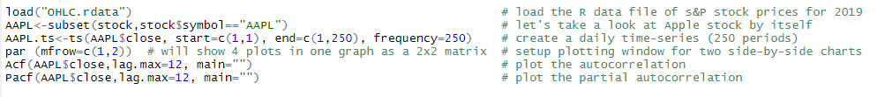
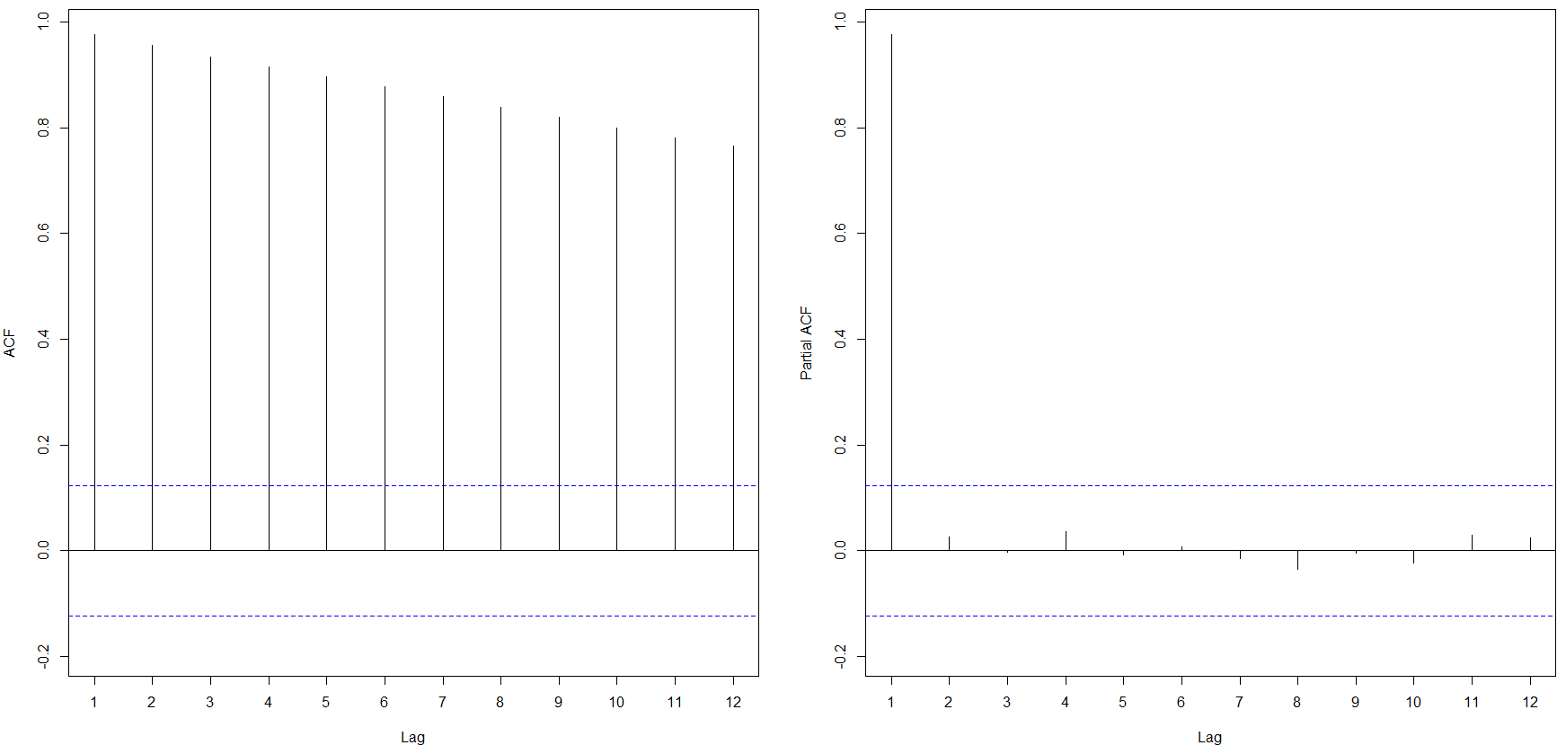
Estimating Autocorrelation
In R, we can evaluate autocorrelation and partial autocorrelation through plots using the functions Acf() and Pacf():

Slide 26
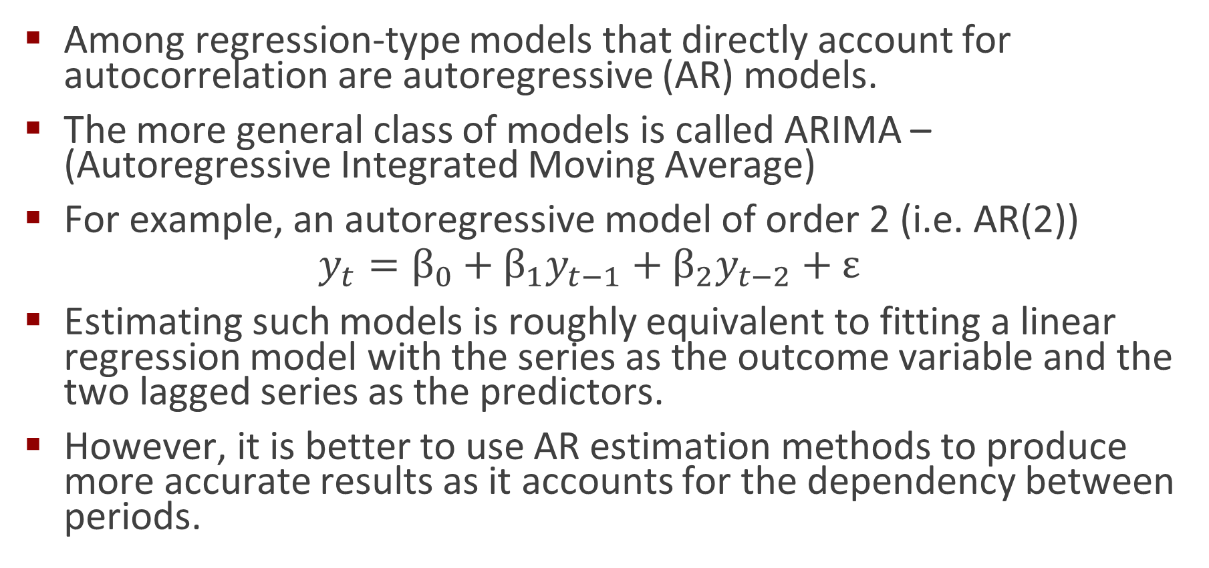
Estimating an Autoregressive Model
Among regression-type models that directly account for autocorrelation are autoregressive (AR) models.
The more general class of models is called ARIMA – (Autoregressive Integrated Moving Average)
For example, an autoregressive model of order 2 (i.e. AR(2))
$${y_{t}=β}_{0}+β_{1}y_{t−1}+β_{2}y_{t−2}+ε$$
Estimating such models is roughly equivalent to fitting a linear regression model with the series as the outcome variable and the two lagged series as the predictors.
However, it is better to use AR estimation methods to produce more accurate results as it accounts for the dependency between periods.

Slide 27
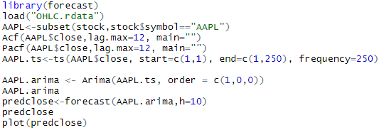
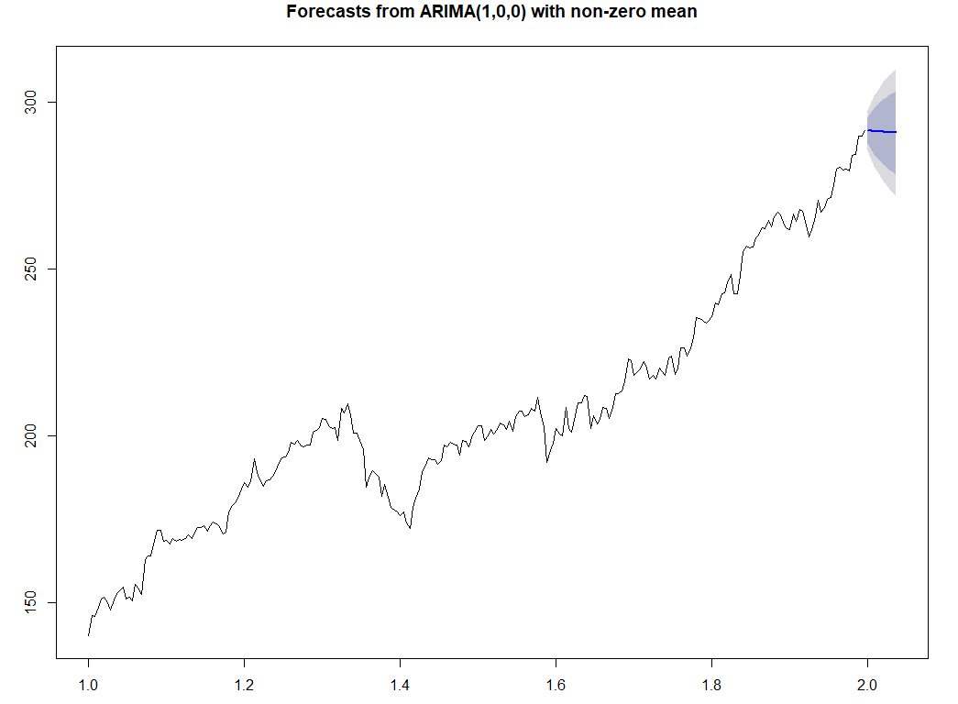
Estimating an AR(1) Model and Making Predictions

Slide 28
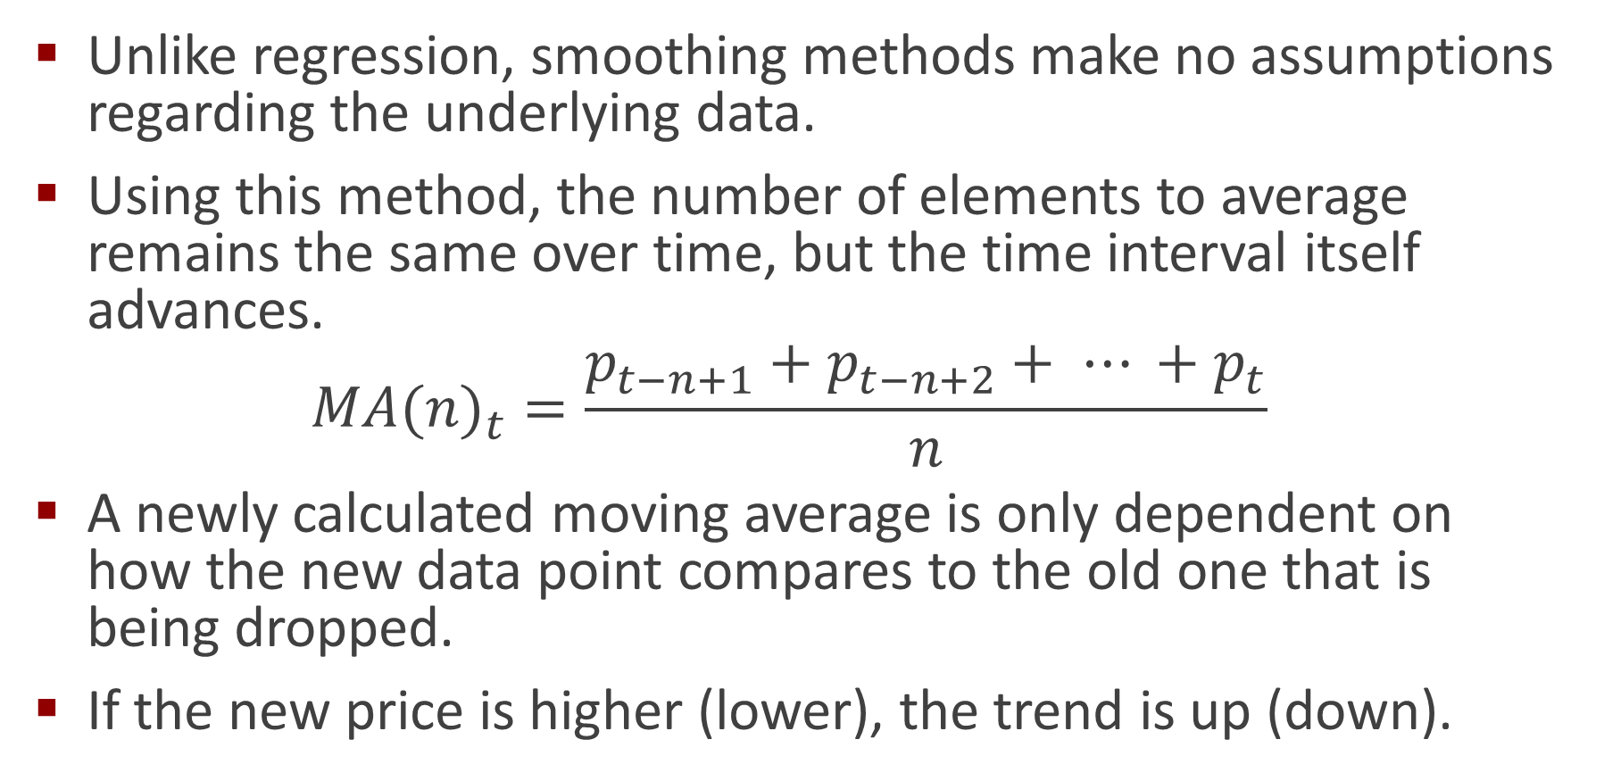
Smoothing Methods: Simple Moving Average
Unlike regression, smoothing methods make no assumptions regarding the underlying data.
Using this method, the number of elements to average remains the same over time, but the time interval itself advances.
$${MA(n)}_{t}=\frac{p_{t−n+1}+p_{t−n+2}+ ⋯ +p_{t}}{n}$$
A newly calculated moving average is only dependent on how the new data point compares to the old one that is being dropped.
If the new price is higher (lower), the trend is up (down).

Slide 29
What Can You Average?
The closing, or daily settlement, is generally accepted as the “true” price of the day.
It is the price used to reconcile brokerage accounts at the end of the day.
A popular alternative is the use of the average of the high, low, and closing prices, representing some sort of center of gravity.
You may also try to the average of the high and low prices, ignoring the closing price entirely.

Slide 30
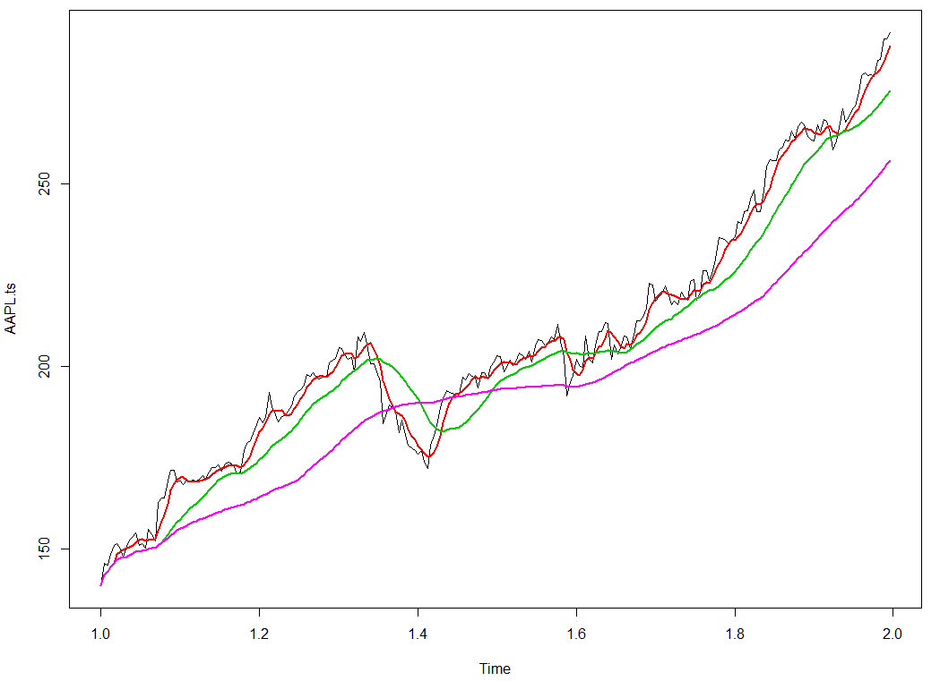
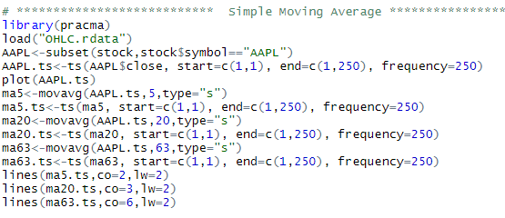
Computing Simple Moving Averages in R
The PRACtical Moving Average (PRACMA) library will compute several types of moving averages.
The basic call is: movavg(data,n,“type”)
For simple moving average, type=“s”

Slide 31
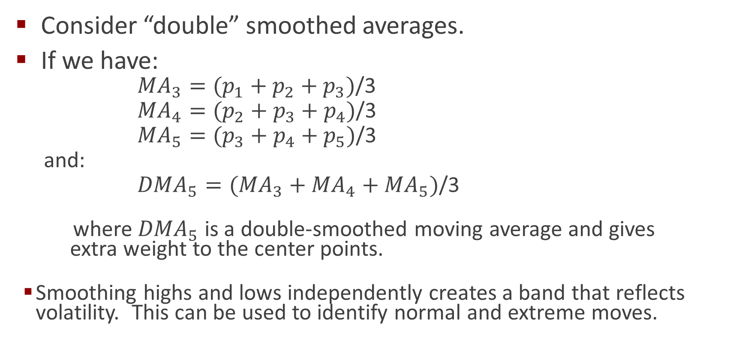
Averaging the Averages…
Consider “double” smoothed averages.
If we have:
${MA}_{3}=(p_{1}+p_{2}+p_{3})$/3
${MA}_{4}=(p_{2}+p_{3}+p_{4})$/3
${MA}_{5}=(p_{3}+p_{4}+p_{5})$/3
and:
${DMA}_{5}=({MA}_{3}+{MA}_{4}+{MA}_{5})$/3
where ${DMA}_{5}$ is a double-smoothed moving average and gives extra weight to the center points.
Smoothing highs and lows independently creates a band that reflects volatility. This can be used to identify normal and extreme moves.

Slide 32
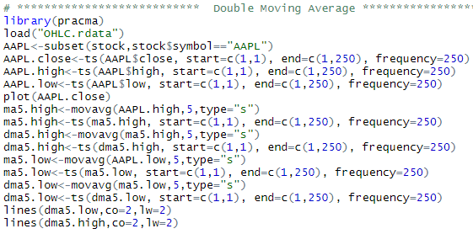
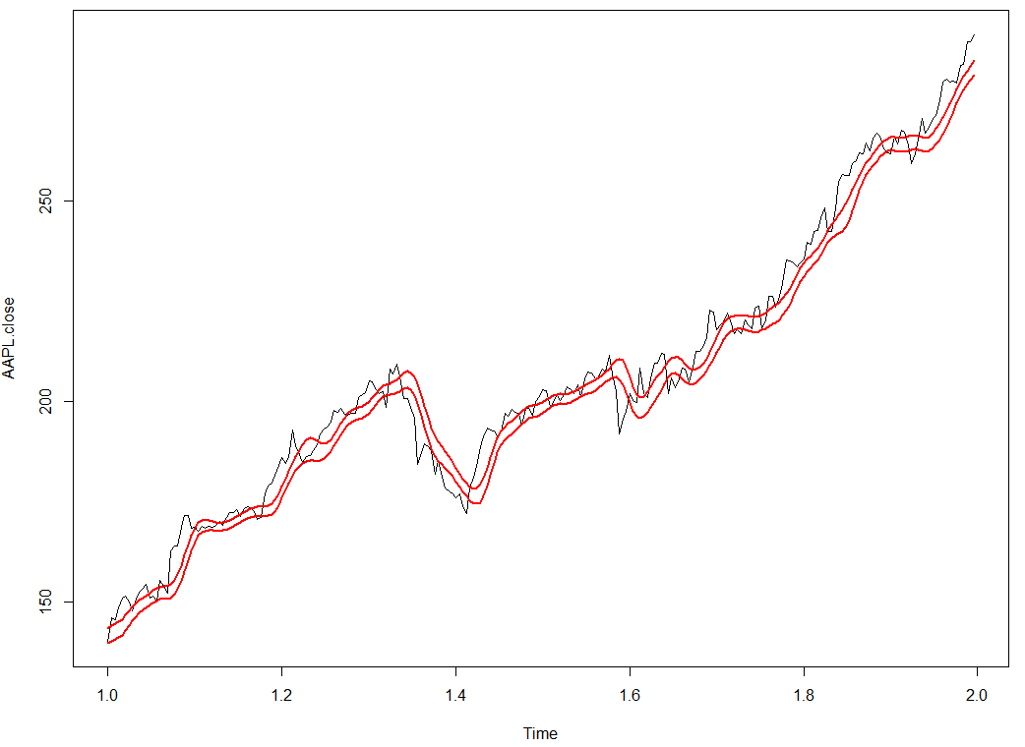
Double Moving Average in R

Slide 33
Types of Moving Averages
Simple moving average: all points treated equally.
Other Methods:
Double Moving Average
Weighted Moving Average
Exponential Smoothing
Methods to incorporate trends and season
Double Exponential Smoothing (Level and Trend)
Triple Exponential Smoothing (Level, Trend, and Season)

Slide 34
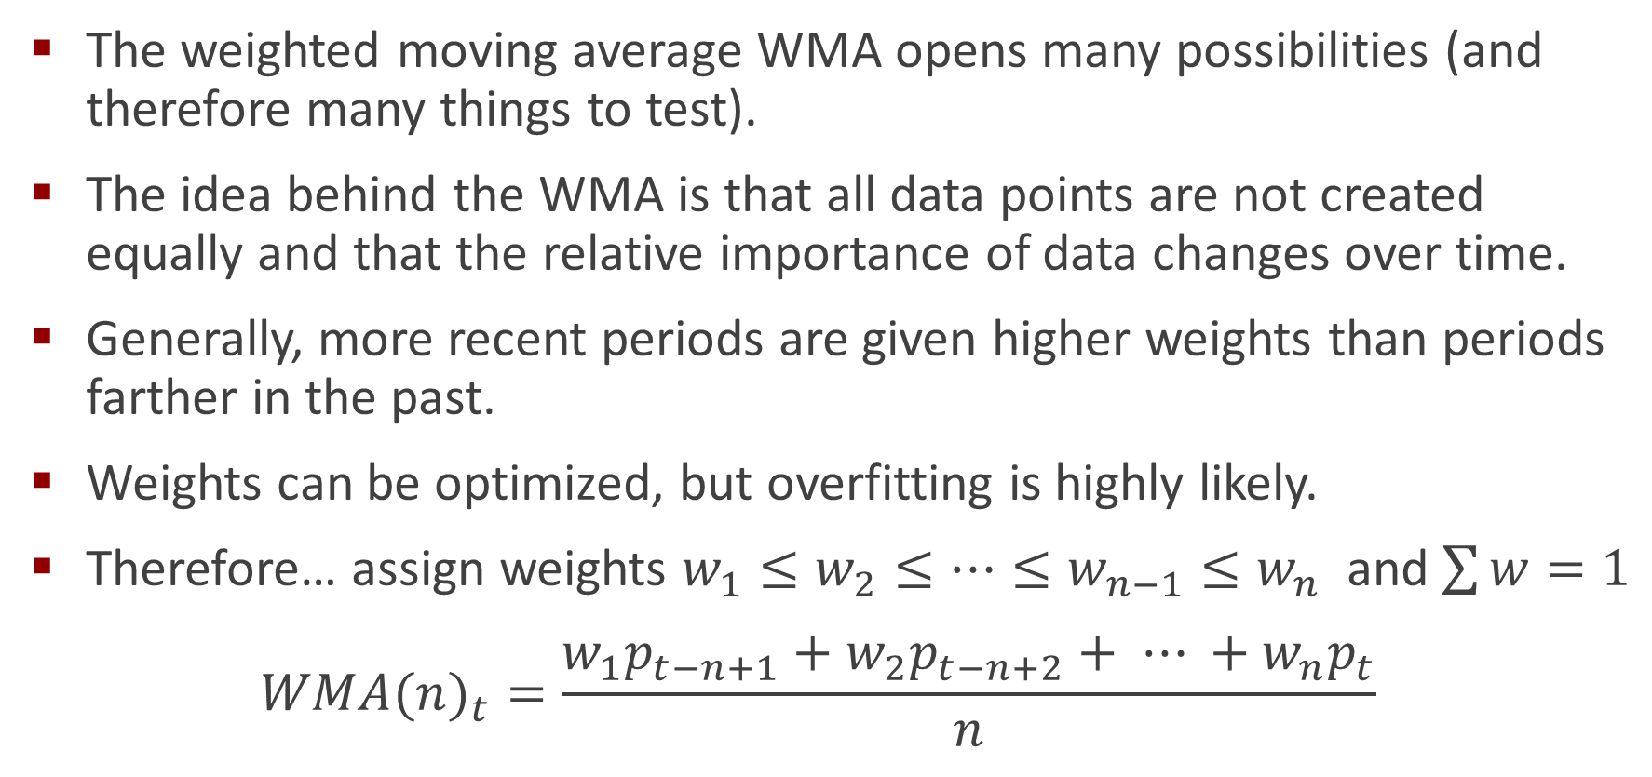
Weighted Moving Average
The weighted moving average WMA opens many possibilities (and therefore many things to test).
The idea behind the WMA is that all data points are not created equally and that the relative importance of data changes over time.
Generally, more recent periods are given higher weights than periods farther in the past.
Weights can be optimized, but overfitting is highly likely.
Therefore… assign weights $w_{1}≤w_{2}≤⋯≤w_{n−1}≤w_{n}$ and $\sum{w}=1$
$${WMA(n)}_{t}=\frac{w_{1}p_{t−n+1}+{w_{2}p}_{t−n+2}+ ⋯ +{w_{n}p}_{t}}{n}$$

Slide 35
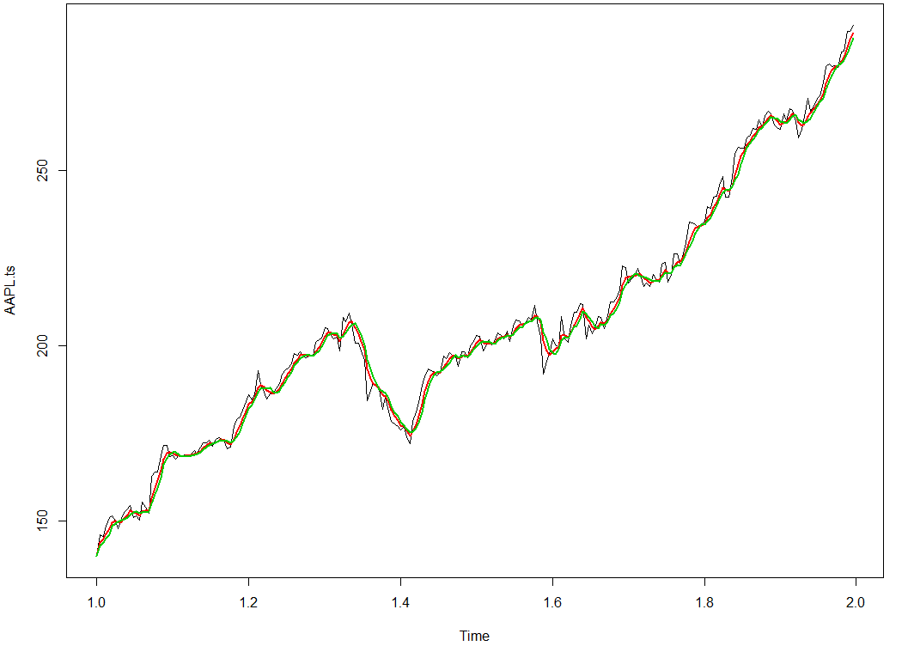
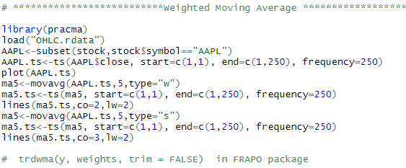
Computing Weighted Moving Averages in R
The PRACtical Moving Average (PRACMA) library will compute several types of moving averages.
The basic call is: movavg(data,n,“type”)
For weighted moving average, type=“w”
Also trdwma() in the FRAPO library

Slide 36
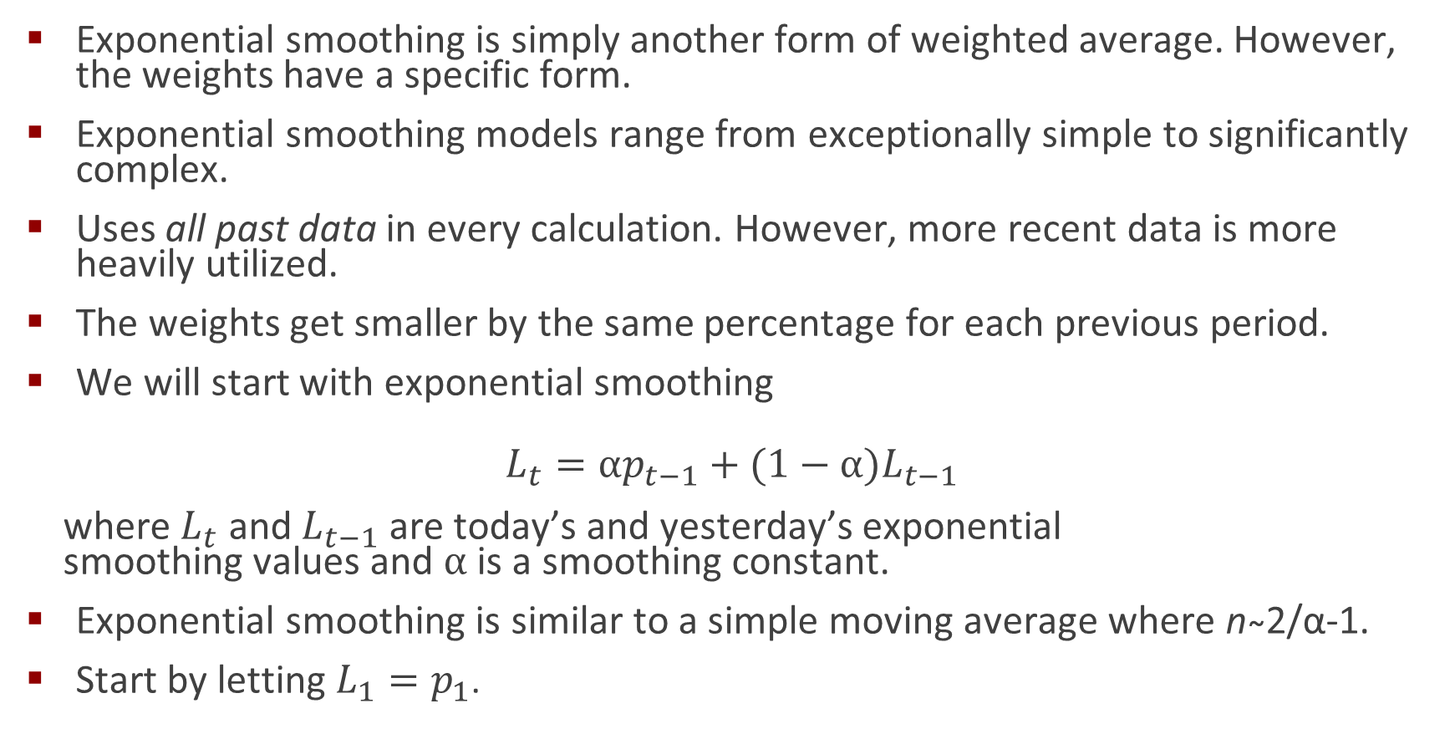
Exponential Smoothing
Exponential smoothing is simply another form of weighted average. However, the weights have a specific form.
Exponential smoothing models range from exceptionally simple to significantly complex.
Uses all past data in every calculation. However, more recent data is more heavily utilized.
The weights get smaller by the same percentage for each previous period.
We will start with exponential smoothing
$$L_{t}={αp_{t−1}+(1−α)L}_{t−1}$$
where $L_{t}$ and $L_{t−1}$ are today’s and yesterday’s exponential smoothing values and $α$ is a smoothing constant.
Exponential smoothing is similar to a simple moving average where n ̴2/α-1.
Start by letting $L_{1}=p_{1}$.

Slide 37
Simple Exponential Smoothing in Action: α=0.2
Week | Price | Forecast
1 | 820 | 820
2 | 775 | 820
3 | 680 | 811
4 | 655 | 785
5 | 750 | 759
6 | 802 | 757
7 | 798 | 766
8 | 689 | 772
9 | 775 | 756
10 |  | 760
$$L_{2}={αp_{1}+(1−α)L}_{1} = 0.2\left(820\right)+0.8(820−820)$$
$$L_{4}={αp_{3}+(1−α)L}_{3} = 0.2\left(811\right)+0.8(680−811)$$
$$L_{6}={αp_{5}+(1−α)L}_{5} = 0.2\left(759\right)+0.8(750−759)$$
$$L_{8}={αp_{7}+(1−α)L}_{7} = 0.2\left(766\right)+0.8(798−766)$$
$$L_{10}={αp_{9}+(1−α)L}_{9} = 0.2\left(756\right)+0.8(775−756)$$

Slide 38
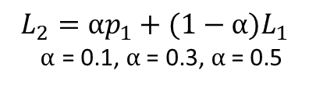
Simple Exponential Smoothing: How Smooth?
As the smoothing parameter (α) changes, so does our reactivity to changes in price (errors).
Big alpha = highly reactive
Small alpha = slow to react
What about other components of demand:
Trend?
Seasonality?
Each of these requires model expansion….
$$L_{2}={αp_{1}+(1−α)L}_{1}$$
$α$ = 0.1, $α$ = 0.3, $α$ = 0.5

Slide 39
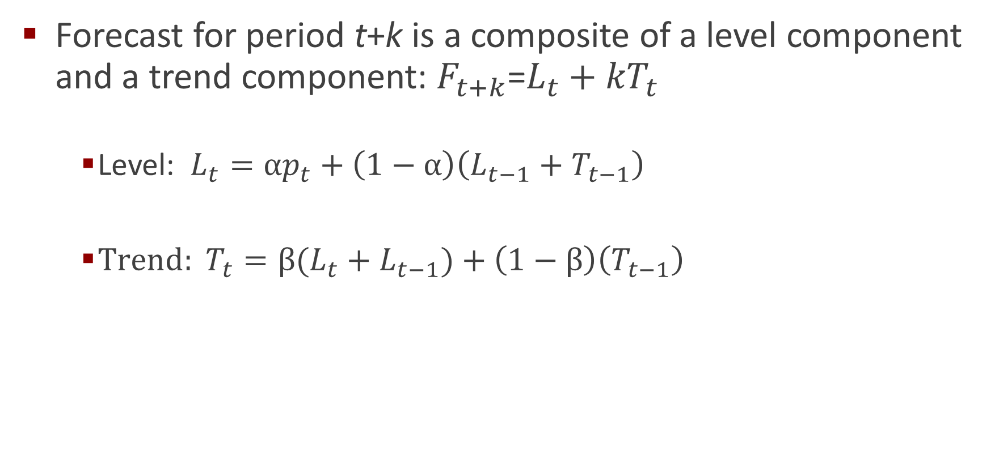
Trend Adjusted Exponential Smoothing
Forecast for period t+k is a composite of a level component and a trend component: $F_{t+k}$=$L_{t}+{kT}_{t}$
Level: $L_{t}={αp}_{t}+\left(1−α\right)\left(L_{t−1}+T_{t−1}\right)$
$Trend: T_{t}=β(L_{t}+L_{t−1})+\left(1−β\right)\left(T_{t−1}\right)$

Slide 40
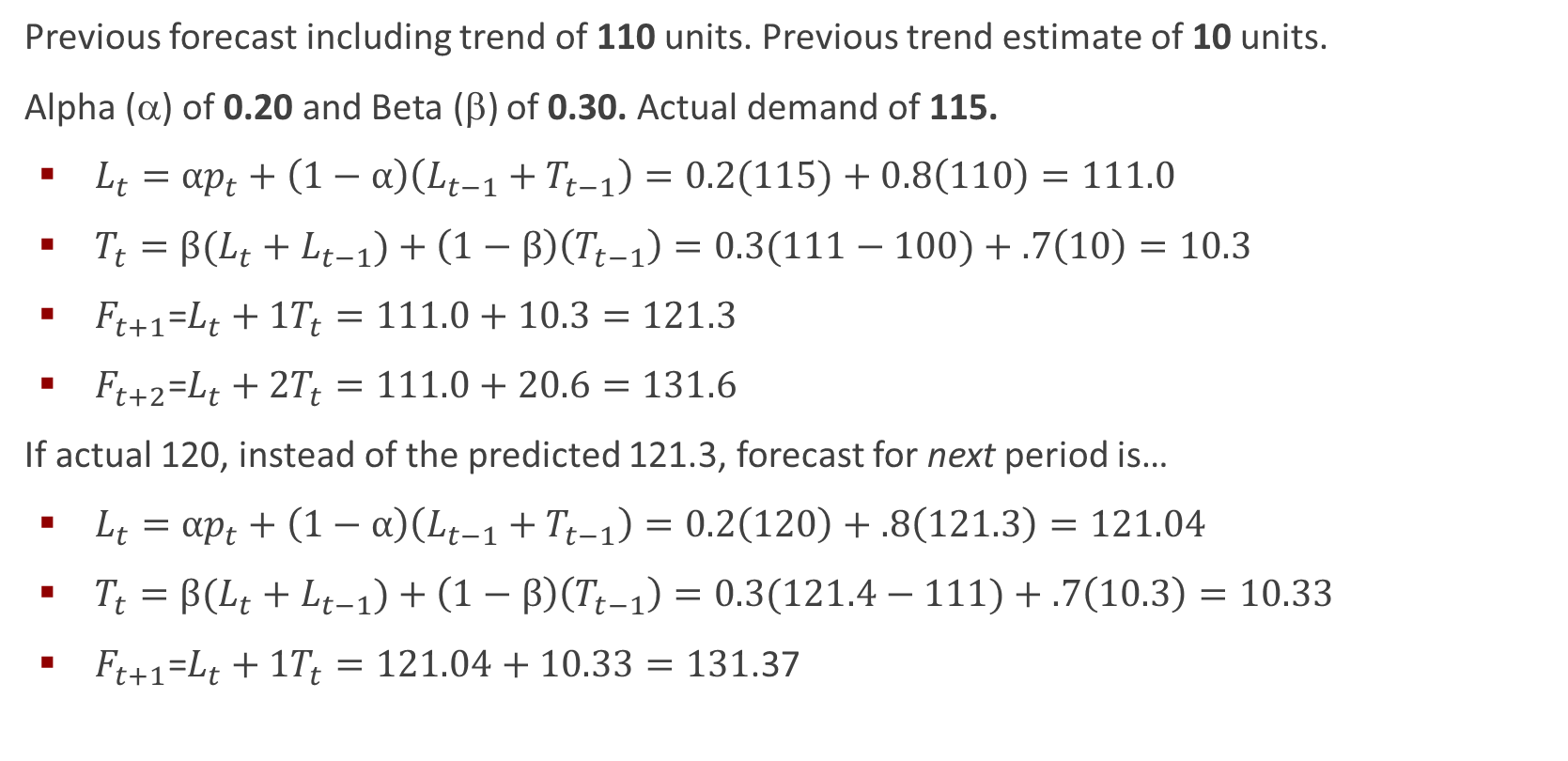
Calculating Level and Trend: An Example
Previous forecast including trend of 110 units. Previous trend estimate of 10 units.
Alpha (α) of 0.20 and Beta (β) of 0.30. Actual demand of 115.
$L_{t}={αp}_{t}+\left(1−α\right)\left(L_{t−1}+T_{t−1}\right)=0.2(115)+0.8\left(110\right)=111.0$
$T_{t}=β(L_{t}+L_{t−1})+\left(1−β\right)\left(T_{t−1}\right)=0.3(111−100)+.7\left(10\right)=10.3$
$F_{t+1}\text{=}L_{t}+{1T}_{t}=111.0+10.3=121.3$
$F_{t+2}\text{=}L_{t}+{2T}_{t}=111.0+20.6=131.6$
If actual 120, instead of the predicted 121.3, forecast for next period is…
$L_{t}={αp}_{t}+\left(1−α\right)\left(L_{t−1}+T_{t−1}\right)=0.2\left(120\right)+.8\left(121.3\right)=121.04$
$T_{t}=β(L_{t}+L_{t−1})+\left(1−β\right)\left(T_{t−1}\right)=0.3(121.4−111)+.7\left(10.3\right)=10.33$
$F_{t+1}\text{=}L_{t}+{1T}_{t}=121.04+10.33=131$.37

Slide 41
What About Seasonality?

Slide 42

Exponential Smoothing with Trend and Seasonality
$F_{t+k}$=($L_{t}+{kT}_{t})S_{t+k−M}$
$L_{t}=\frac{αp_{t}}{S_{t−M}}+\left(1−α\right)\left(L_{t−1}+T_{t−1}\right)$
$T_{t}=β(L_{t}+L_{t−1})+\left(1−β\right)\left(T_{t−1}\right)$
$S_{t}=\frac{γp_{t}}{L_{t}}+(1−γ)$ $S_{t−M}$

Slide 43
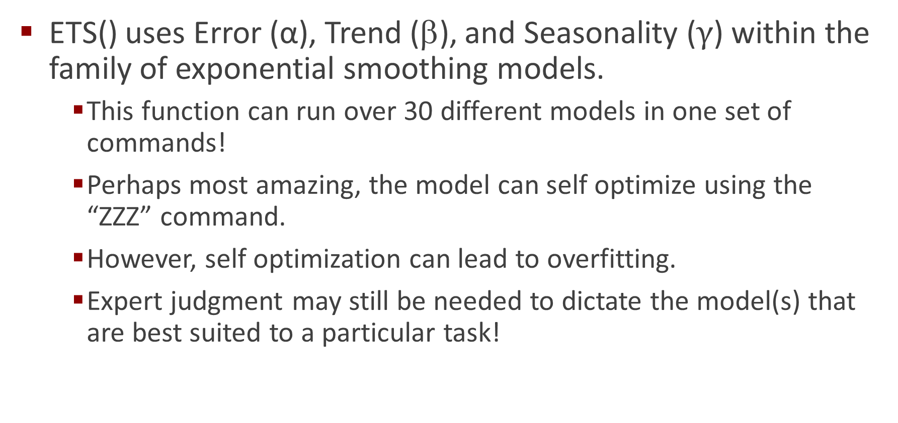
Bring on the ets() Function in R
ETS() uses Error (α), Trend (β), and Seasonality ($γ$) within the family of exponential smoothing models.
This function can run over 30 different models in one set of commands!
Perhaps most amazing, the model can self optimize using the “ZZZ” command.
However, self optimization can lead to overfitting.
Expert judgment may still be needed to dictate the model(s) that are best suited to a particular task!

Slide 44
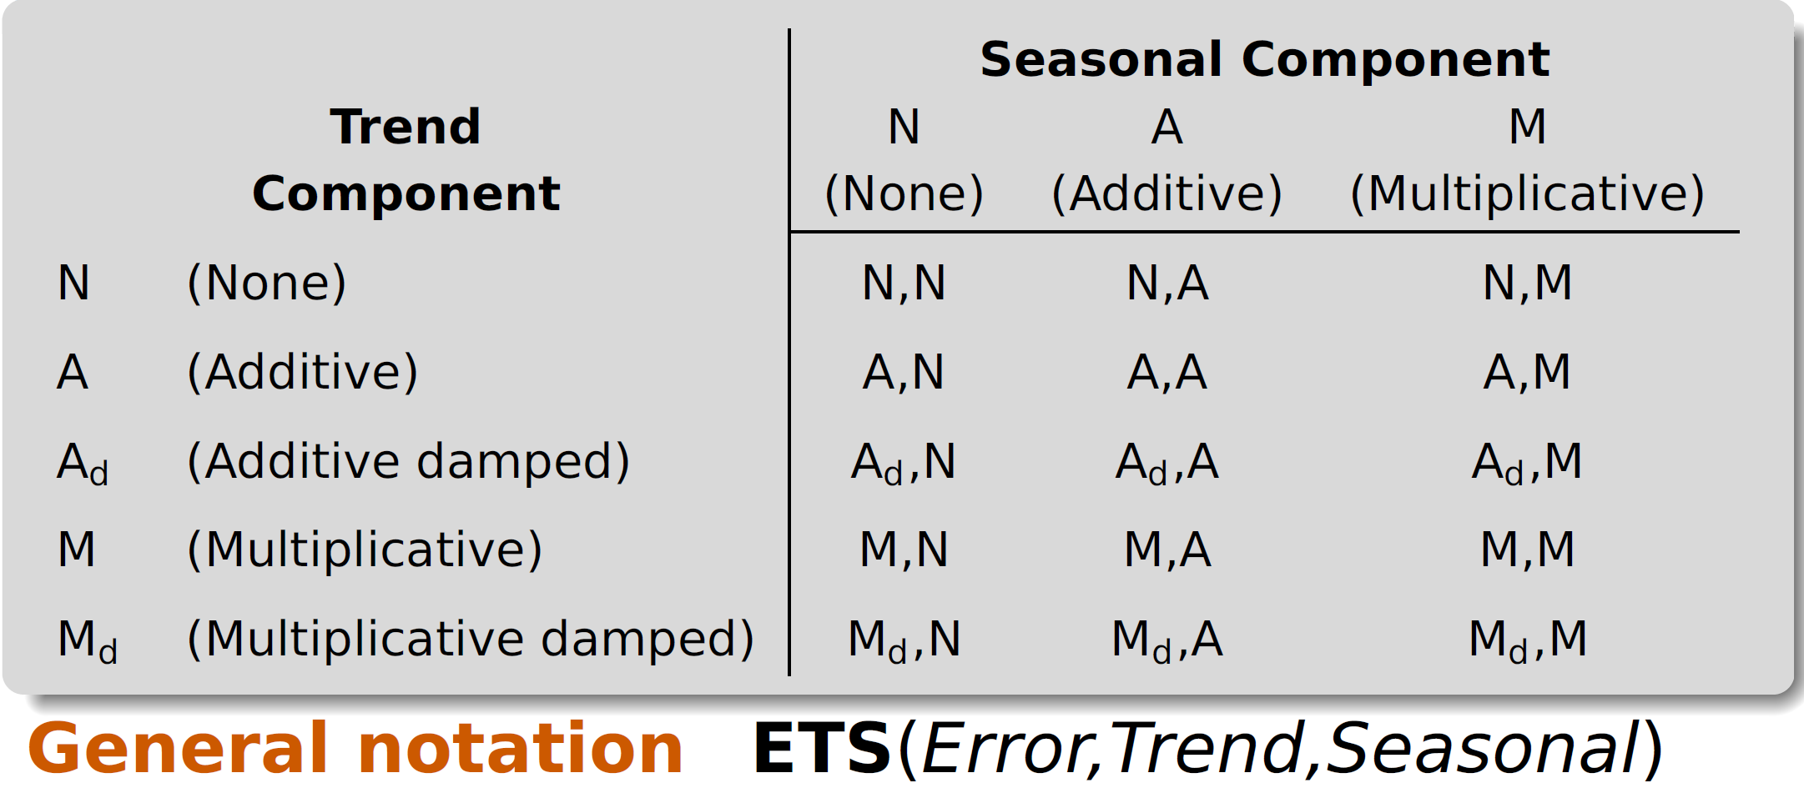
Arguments for ets()
Note: For long range forecasting, use damped coefficients to prevent “noise” from entering the model. ETS(data, model, damped=TRUE). Also note that the default setting is damped=FALSE.
ets(data.set, model=“ANN”): Additive Error, No Trend, No Seasonality
est(data.set, model=“AAN”): Additive Error, Additive Trend, No Seasonality
ets(data.set, model=“AAA”): Additive Error, Additive Trend, Additive Seasonality

Slide 45
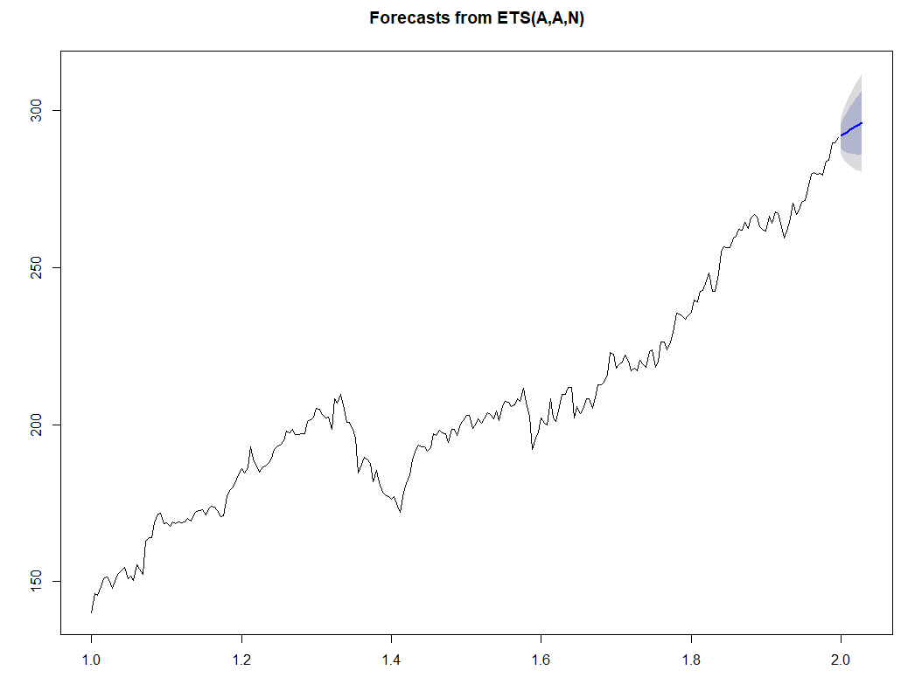
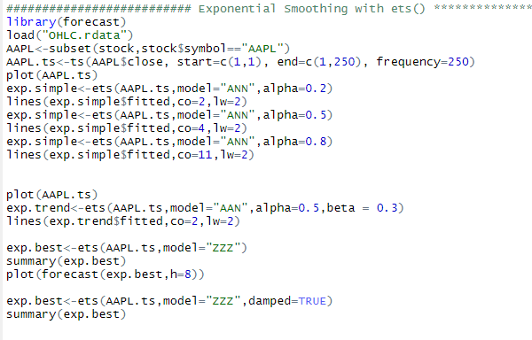
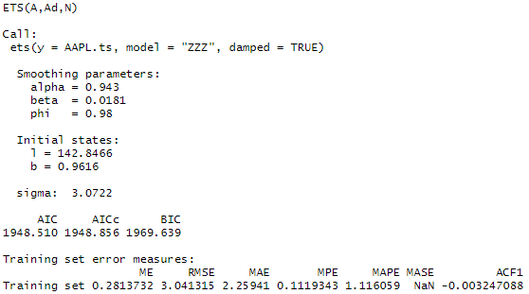
Executing ets() in R

Slide 46
Parting Thoughts
Time series resides at the heart of our analysis and the automated trading systems we develop. We have hit but the tip of the iceberg here.
Our analysis has also touched upon the issues confronting us in testing and backtesting. A launching point for our next two classes.

